Slide 1
Capstone Engagement
Assessment, Analysis, and Hardening of a Vulnerable System

Slide 2
Table of Contents
This document contains the following sections:
01
Network Topology
02
Red Team: Security Assessment
03
Blue Team: Log Analysis and Attack Characterization
Hardening: Proposed Alarms and Mitigation Strategies
04

Slide 3
Network Topology
3

Slide 4
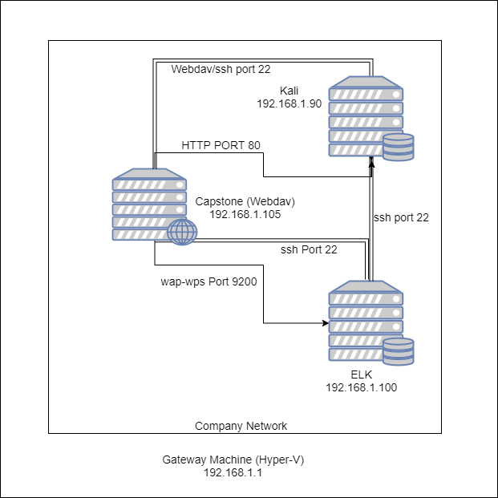
Network Topology
Network
Address Range: 192.168.1.0/24
Netmask: 255.255.255.0 = 24
Gateway: 192.168.1.1
Machines
IPv4: 192.168.1.100
OS: Unbutu
Hostname: ELK
IPv4: 192.168.1.105
OS: Unbutu
Hostname: Capstone
IPv4: 192.168.1.90
OS: unbutu
Hostname: Kali

Slide 5

Red Team
Security Assessment
5

Slide 6
Recon: Describing the Target
Nmap identified the following hosts on the network:
Hostname | IP Address | Role on Network
Capstone (Webdav) | 192.168.1.105 | Company Webserver
Kali | 192.168.1.90 | Pen Testing Machine: Use to search for vulnerabilities.
ELK | 192.168.1.100 | House all the logs to include Metricbeat, Filebeat and Packetbeat
Gateway Machine | 192.168.1.1 | Allow Access to the company network

Slide 7
Vulnerability Assessment
The assessment uncovered the following critical vulnerabilities in the target:
Vulnerability | Description | Impact
Path Traversal | A path traversal attack or directory traversal aims to access files and directories that are stored outside the web root folder. | An attacker can gain access to sensitive and system information on the system, delete or modify files
Weak Password Policy | Password strength is the measure of effectiveness a password resists guessing and brute force attacks. | Weak passwords are an easy target for brute force attacks which will lead to compromise system security.
File Inclusion | It is when an application builds a path to execute codes using an attacker-controlled variable in a way that allows the attacker to control which file is executed at run time. | Successful exploitation of a file inclusion vulnerability will result in remote code execution on the web server that runs the affected web application.

Slide 8
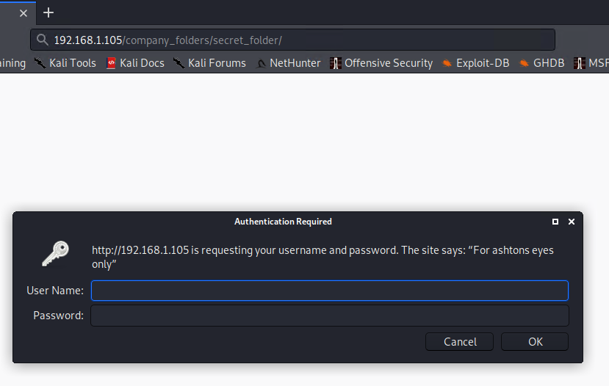
Exploitation: Path Traversal
01
02
03
Tools & Processes
After using NMAP 192.168.1.0/24, I find out that Port 80 was opened.
By typing the absolute path to the folder in the Uniform Resource Locator (URL) search bar. I was able to access a secret folder.
Achievements
It allowed me to access a password protected file within the network
[INSERT: screenshot or command output illustrating the exploit.]

Slide 9
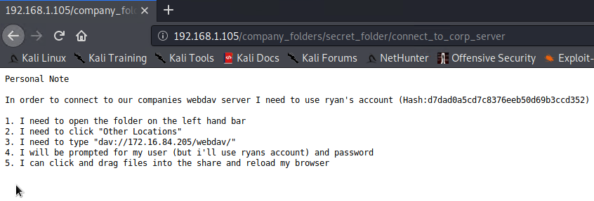
Exploitation: Weak Password Policy
01
02
03
Tools & Processes
I used Hydra to crack Ashton’s password
hydra -l ashton -P /usr/share/wordlists/rockyou.txt -s 80 -f -vV 192.168.1.105 http-get /company_folders/secret_folder
Achievements
The exploit gave me the ‘How to’ and appropriate credential to log on to the company server.

Slide 10
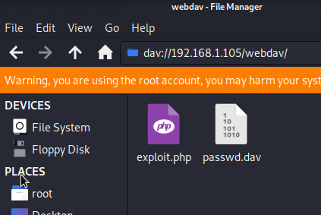
Exploitation: File Inclusion
01
02
03
Tools & Processes
I was able to use msfvenom to create a php reverse shell payload and upload that payload within the company server using webdav.
Achievements
Successful exploitation of PHP file inclusion may result in information disclosure or compromise of the vulnerable system. A remote attacker can read and write files or execute arbitrary code on the target system with privileges of the web server

Slide 11

Blue Team
Log Analysis and Attack Characterization
11

Slide 12

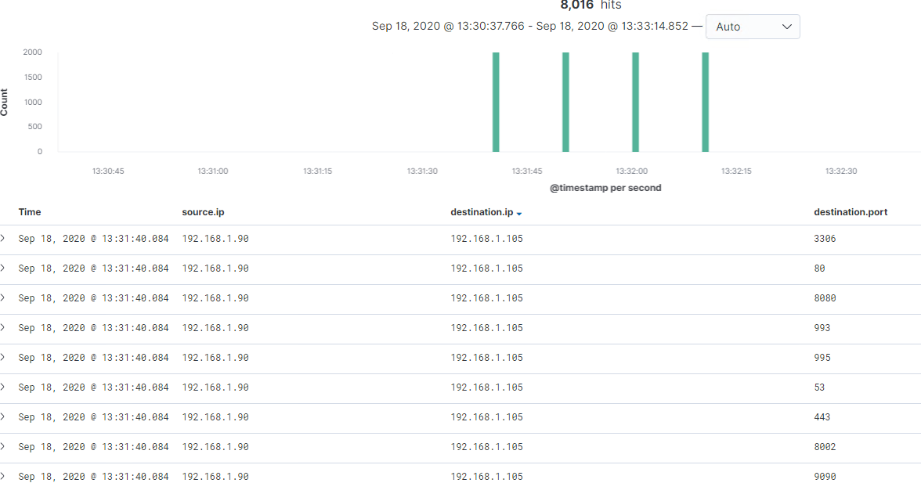
Analysis: Identifying the Port Scan
Answer the following questions in bullet points under the screenshot if space allows. Otherwise, add the answers to speaker notes.
What time did the port scan occur? 2202
How many packets were sent, and from which IP?
What indicates that this was a port scan?
[Insert Here]
Include a screenshot of Kibana logs depicting the port scan.
This port scan started at 13:31:36 to 13:32:10
8016 packets were recorded
A TCP connection where the Source IP and Destination IP remained the same, while the destination port is changing during a shot period of time

Slide 13
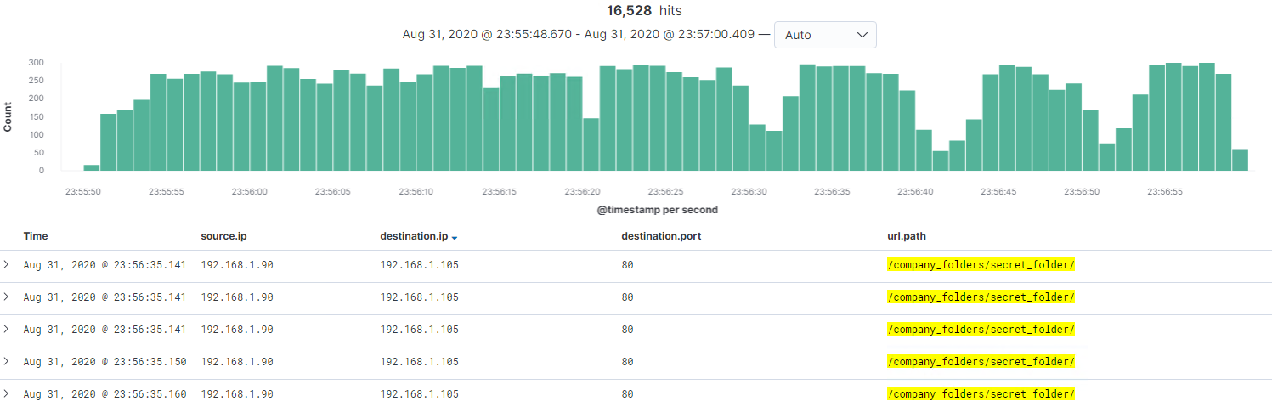
Analysis: Finding the Request for the Hidden Directory
Answer the following questions in bullet points under the screenshot if space allows. Otherwise, add the answers to speaker notes.
What time did the request occur? How many requests were made?
Which files were requested? What did they contain?
[Insert Here]
Include a screenshot of Kibana logs depicting the request for the hidden directory.
Time: 23:55:50 to 23:56:59
A total of 16528 requests
Associated Company files
The file contains instructions on how to access the server and employee names, blogs…

Slide 14
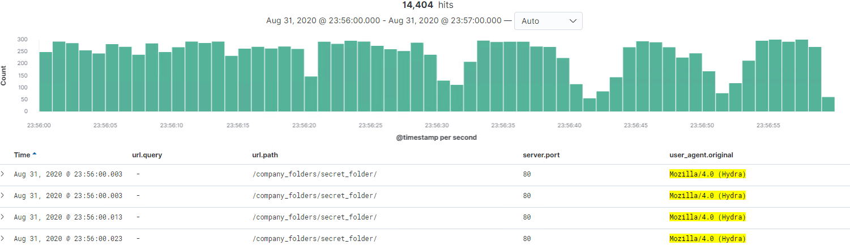
Analysis: Uncovering the Brute Force Attack
Answer the following questions in bullet points under the screenshot if space allows. Otherwise, add the answers to speaker notes.
How many requests were made in the attack?
How many requests had been made before the attacker discovered the password?
[Insert Here]
Include a screenshot of Kibana logs depicting the brute force attack.
14,404 requests were made
14,402 Error requests were made

Slide 15
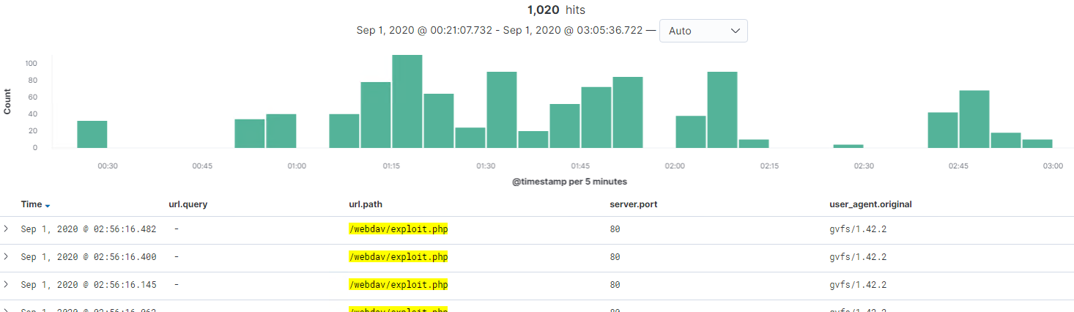
Analysis: Finding the WebDAV Connection
Answer the following questions in bullet points under the screenshot if space allows. Otherwise, add the answers to speaker notes.
How many requests were made to this directory?
Which files were requested?
[Insert Here]
Add a screenshot of Kibana logs depicting the WebDAV connection.
1020 requests were made
Exploit.php, payload.php, and passwd.dav

Slide 16
Blue Team
Proposed Alarms and Mitigation Strategies
16

Slide 17
Mitigation: Blocking the Port Scan
What kind of alarm can be set to detect future port scans?
Monitor for multiple requests to an IP on different Ports.
What threshold would you set to activate this alarm? No more than five
What configurations can be set on the host to mitigate port scans?
Do not allow the host IP to communicate with Unknown IPs or provide a port range to handle dynamic ports. Best of all, close all ports that does not need to be open.
Describe the solution. If possible, provide required command lines. This solution will reduce possilbe access points to the server and make it harder for hackers to gain access to the server.
Notes:
How can I meet the audit requirement for removing Open Ports and Protocols if I need specific ports for essential business services? Again, CIS Control 9 and indeed any Security Auditor acknowledge that business services do need to network accessible and there will always be open ports within any network, hence the supplementary guidance “Apply host-based firewalls or port filtering tools on end systems, with a default-deny rule that drops all traffic except those services and ports that are explicitly allowed”, and “Place application firewalls in front of any critical servers to verify and validate the traffic going to the server. Any unauthorized traffic should be blocked and logged”
https://www.newnettechnologies.com/downloads/NNT-Open-Port-Hardening-Guide.pdf

Slide 18
Mitigation: Finding the Request for the Hidden Directory
What kind of alarm can be set to detect future unauthorized access?
Any attempt to access the server directory via the URL.
Use filter to block URLs containing command or escape code
What threshold would you set to activate this alarm? 0
What configuration can be set on the host to block unwanted access?
First, move HTTP access to port 443
Validate users input from browser
Keep up to date with current patches
Describe the solution. If possible, provide required command lines.
Path traversal attacks rely on two vulnerable elements: the web application code and the web server configuration. By taking care to avoid vulnerabilities in both areas, you can mitigate the majority of such attacks.

Slide 19
Mitigation: Preventing Brute Force Attacks
What kind of alarm can be set to detect future brute force attacks?
Number of unsuccessful logins in a specific time frame
Lock Account after a specified unsuccessful logins and send an alarm
What threshold would you set to activate this alarm?
After 4 attempts, lock account for 10 min
What configuration can be set on the host to block brute force attacks?
Limit logins to a Specified IP address
2 Factor Authentication
Account Lockout after Failed attempts
Increase password complexity
Describe the solution. If possible, provide the required command line(s).
There is no such thing as 100% safe, but by applying these measures would prevent brute force attack.

Slide 20
Mitigation: Detecting the WebDAV Connection
What kind of alarm can be set to detect future access to this directory?
Monitor who access the server and what they are doing base on their privilege, send alarm for every violation.
What threshold would you set to activate this alarm? 1
What configuration can be set on the host to control access?
Limit privileges and points of administration
Use secure protocols
Restrict access
Describe the solution. If possible, provide the required command line(s).
While every employee might need access to the server, not all of them require total access. Only give access to what they need.

Slide 21
Mitigation: Identifying Reverse Shell Uploads
What configuration can be set on the host to block file uploads?
Store uploaded files in a database
Configure a folder inside of web root as web inaccessible
File names and extensions of uploaded files should be change
Describe the solution. If possible, provide the required command line.
shell upload vulnerabilities can be effectively prevented by blocking direct access to uploaded files and limiting the ability of users to upload files.
What kind of alarm can be set to detect future file uploads?
Define allowable type of file that user can upload
What threshold would you set to activate this alarm? 1
Notes:
https://blog.securityinnovation.com/blog/2014/01/preventing-shell-upload-vulnerabilities-in-php.html

